Slide 1

SPRING FRAMEWORK 5 OVERVIEW

Slide 2

• Getting Started with Spring and Hibernate:
Dev Environment
• Apply Spring Inversion of Control / Dependency Injection
• Perform object/relational mapping with Hibernate
• Leverage the Hibernate API to develop CRUD apps

Slide 3
Why Spring?
• Very popular framework for building Java applications
• Initially a simpler and lightweight alternative to J2EE
• Provides a large number of helper classes … makes things easier
• Java EE Development without EJB in order to Simplify Java Enterprise Development

Slide 4
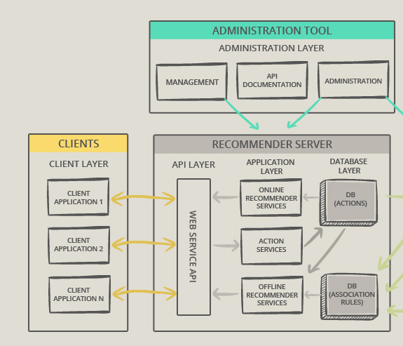
JAVA ENTERPRISE APPLICATION ARCHITECTURE

Slide 5
Goals of Spring
• Lightweight development with Java POJOs (Plain-Old-Java-Objects) • Dependency injection to promote loose coupling • Declarative programming with Aspect-Oriented-Programming (AOP) • Minimize boilerplate Java code
Spring Website – Official Website: www.spring.io

Slide 6
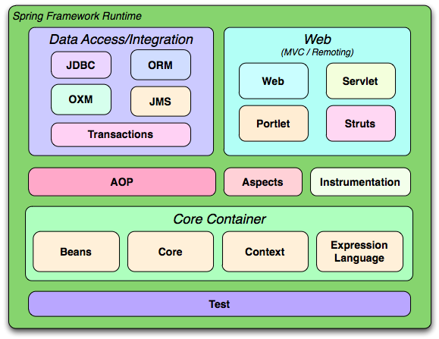
Spring Framework Modules
https://docs.spring.io/spring/docs/3.0.0.RC2/spring-framework-reference/html/ch01s02.html#d0e268

Slide 7
Spring Main Projects
https://docs.spring.io/spring/docs/3.0.0.RC2/spring-framework-reference/html/pt01.htmlhttps://spring.io/projects

Slide 8
SET UP YOUR ENVIRONMENT
Java Application Server – Tomcat
• Start Tomcat from Eclipse
• Easily deploy applications directly to Tomcat
2. Java Integrated Development Environment (IDE) - Eclipse
To Do List
1. Create Eclipse Project
2. Download Spring JAR Files
3. Add JAR ﬁles to Eclipse Project … Build Path
What about Maven ?
• Instead of manually downloading you can use a tool like Maven

